Slide 1

Traffic Severity Prediction Using Machine Learning and Deep Learning
Batch No. A2
A.J.Shruthi 218R1A6701
A.Srikanth 218R1A6705
S.Vivek Chary 218R1A6753
Under the Guidance of
Mrs G.Shruthi
Assistant Professor, Department of CSE-DS

Slide 2
Outline
Introduction .
Literature survey
Existing System
Objectives of Proposed research work
Software & Hardware Requirements
Block Diagram of Proposal
UML diagrams
Implementation Code
Testing
Results
Conclusions & Future Enhancement
References

Slide 3
Introduction
Road traffic accidents cause injuries, deaths, disabilities, and property loss, impacting both the economy and healthcare systems by increasing the burden on hospitals.
This project uses Machine Learning (ML) and Deep Learning (DL) to predict accident severity based on factors like weather, road type, and time of day.
The system integrates Random Forest (RF) for feature selection and Convolutional Neural Networks (CNN) for identifying patterns, improving prediction accuracy.
The model analyzes multiple factors, including weather conditions, road infrastructure, traffic density, and time variables, to classify accident severity.
The system helps in early risk detection, better emergency response, and smarter traffic management, making roads safer and improving urban transportation systems.

Slide 4
Introduction
The system predicts accident severity, enabling authorities to take preventive measures in high-risk areas.
Emergency services can use these predictions to respond faster and manage resources effectively.
Integrating the model with smart traffic systems helps adjust signals and reroute traffic to reduce congestion.
City planners can use the model’s insights to design safer roads, crossings, and bike lanes.
The system improves traffic flow, enhances emergency response, and makes predictions faster and more efficient by focusing on key features.

Slide 5
Introduction
Traditional systems use fixed rules, making them ineffective in handling sudden changes like road closures, accidents, or bad weather.
Bayesian models need expert knowledge to set complex rules, making them difficult to build and maintain.
ANN models require powerful hardware and a lot of time for training, making them hard to use in low-resource environments.
While SVM models work well with small datasets, they struggle to handle large-scale traffic data, reducing their efficiency.

Slide 6
Introduction
The Ensemble Fusion Classifier (EFC) combines multiple models, reducing overfitting and ensuring strong performance in different traffic conditions.
The EFC model uses lightweight yet powerful algorithms, making it fast and accurate for real-time traffic management.
The model effectively handles noisy, incomplete, or inconsistent data, ensuring stable and reliable performance.
The EFC system adapts well to different regions and varied traffic conditions by incorporating local features and environmental factors.
The combination of multiple models improves prediction accuracy, making the system highly effective in identifying accident severity.

Slide 7
Literature Survey
Ref. No. | Title | Objective | Method/ Algorithm used | Year of publication
1 | BConvLSTM: A Deep Learning-Based Technique for Severity Prediction of a Traffic Crash | To develop a deep learning framework for predicting traffic crash severity by processing input data through a preprocessing step. | Bi-directional Convolutional Long Short-Term Memory (BConvLSTM) | 2024
2 | Evaluating the Effectiveness of Machine Learning Techniques in Forecasting the Severity of Traffic Accidents | To assess various machine learning models in predicting traffic accident severity based on contributing factors. | Naive Bayes, Random Forest, Logistic Regression, Artificial Neural Networks | 2023

Slide 8
Literature Survey
Ref. No. | Title | Objective | Method/ Algorithm used | Year of publication
3 | Deep Learning for Traffic Prediction and Trend Deviation Identification: A Case Study in Hong Kong | To introduce a robust methodology for predicting traffic volume and speed on major strategic routes using deep learning models. | Convolutional Neural Network (CNN) and Long Short-Term Memory (LSTM) | 2023
4 | Road Accident Severity Prediction Using Machine Learning Algorithms | To develop a predictive model for accident severity using a combination of machine learning algorithms and analyze traffic data to identify factors influencing road accidents. | Logistic Regression, Decision Tree, Random Forest Classifier | 2021

Slide 9
Literature Survey
Ref. No. | Title | Objective | Method/ Algorithm used | Year of publication
5 | Using Machine Learning Models to Forecast Severity Level of Traffic Crashes by R Studio and ArcGIS | To forecast the severity level of traffic crashes using machine learning models and geographic information system (GIS) tools. | Logistic Regression, Decision Tree, Random Forest Classifier | 2019
6 | Traffic Incident Duration Prediction via a Deep Learning Framework for Text Description Encoding | To predict the duration of traffic incidents by integrating machine learning with traffic flow/speed and incident description as features, encoded via deep learning methods. | Deep Learning framework integrating ANN autoencoder and character-level LSTM-ANN sentiment classifier | 2018

Slide 10
Existing System
Traditional traffic management systems rely on predefined rules and thresholds to assess traffic conditions and predict accident severity. These systems are limited in handling dynamic and complex traffic patterns.
Bayesian models are utilized to predict traffic severity by establishing probabilistic relationships between various contributing factors. They perform well in uncertainty-driven scenarios but may require extensive domain knowledge.
ANNs are applied to model complex patterns in traffic data, but they may demand high computational resources and extensive tuning for optimal performance.
SVM models have been employed to classify accident severity efficiently, particularly when dealing with small-to-medium-sized datasets.
GIS-based systems visualize accident-prone zones and predict traffic severity based on spatial data. These systems are effective for region-specific predictions.

Slide 11
Objectives of Proposed System
The proposed system introduces an Ensemble Fusion Classifier (EFC) that combines both Machine Learning (ML) and Deep Learning (DL) models. This hybrid approach leverages the strengths of both techniques to enhance accident severity prediction, improving accuracy and robustness.
The system integrates Random Forest (RF) to identify the most influential features and Convolutional Neural Network (CNN) for recognizing complex patterns in traffic data. This combination ensures effective feature learning and classification.
The model selects the top 20 significant features (such as distance, temperature, and visibility) to focus only on the most relevant data points. This reduces computational load while maintaining high predictive accuracy.
The system employs a soft voting mechanism that combines prediction probabilities from multiple models. This technique enhances decision reliability by reducing errors caused by individual model biases.

Slide 12
Objectives of Proposed System
The EFC model efficiently handles noisy data, missing values, and outliers. By improving data preprocessing and feature selection, the system ensures stable and consistent performance even with incomplete or inconsistent data.
The EFC model achieved outstanding results with 98.8% accuracy, 97.3% precision, 98.5% recall, and 98.4% F1 score, outperforming traditional models in all aspects.
The system is designed to deliver real-time predictions, ensuring quick and accurate results, making it suitable for intelligent traffic management systems and smart city solutions.
The EFC model is flexible and scalable, enabling it to adapt effectively to different regions, diverse traffic conditions, and various environmental factors, ensuring widespread applicability.

Slide 13
Software & Hardware Requirements
HARDWARE REQUIRMENTS :
•System : i3 or above.
•Ram : 4 GB.
•Hard Disk : 40 GB
SOFTWARE REQUIRMENTS :
•Operating system : Windows8 or Above.
•Coding Language : python

Slide 14
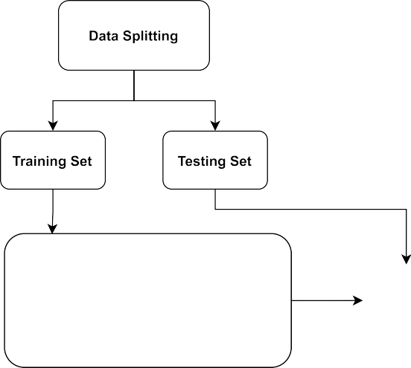

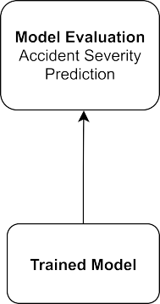

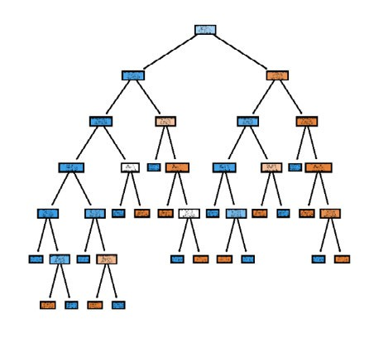


Block Diagram of Proposal

Slide 15
UML Diagrams
USE CASE DIAGRAM

Slide 16
UML Diagrams
SEQUENCE DIAGRAM

Slide 17
UML Diagrams
CLASS DIAGRAM:

Slide 18
UML Diagrams
COLLABORATION DIAGRAM

Slide 19
Testing
The proposed system was tested using the US road accident dataset, containing records from February 2016 to June 2021, with data split into 70% for training and 30% for testing to ensure reliable evaluation.
The testing process involved two phases: first using all 48 features, and second using the top 20 significant features identified by Random Forest, which improved both accuracy and computational efficiency.
Key evaluation metrics such as Accuracy, Precision, Recall, and F-score were used to assess the model’s performance, ensuring comprehensive evaluation.
The EFC model’s results were compared against traditional classifiers like Random Forest (RF), AdaBoost (AB), Extra Tree Classifier (ETC), Gradient Boosting Machine (GBM), and Voting Classifier (LR + SGD).

Slide 20
Implementation Code
from tkinter import *
from tkinter import filedialog
main = Tk()
main.title("RFCNN: Traffic Accident Severity Prediction")
main.geometry("1300x1200")
main.config(bg='turquoise')
font = ('times', 16, 'bold')
Label(main, text='RFCNN: Traffic Accident Severity Prediction',
bg='dark goldenrod', fg='white', font=font, height=3, width=120).place(x=0, y=5)
font1 = ('times', 13, 'bold')
Button(main, text="Upload Dataset", command=uploadDataset, font=font1).place(x=900, y=100)
Button(main, text="Feature Extraction", command=featuresExtraction, font=font1).place(x=900, y=200)
Button(main, text="Split Data", command=splitDataset, font=font1).place(x=900, y=250)Button(main, text="Run Classifiers", command=runAllFeatures, font=font1).place(x=900, y=300)
Button(main, text="Comparison Graph", command=graph, font=font1).place(x=900, y=400)
Text(main, height=30, width=100, font=('times', 12)).place(x=10, y=100)
main.mainloop()

Slide 21
Testing
The EFC model achieved outstanding results with an Accuracy of 0.991, Precision of 0.974, Recall of 0.986, and an F-score of 0.980, outperforming all baseline models.
The model was tested on noisy data to evaluate its robustness and successfully maintained stable performance, proving its resilience against incomplete or inconsistent datasets.
Overall, the EFC model demonstrated superior accuracy, improved prediction stability, and effective handling of real-world traffic data, making it suitable for real-time traffic monitoring and accident severity prediction.

Slide 22

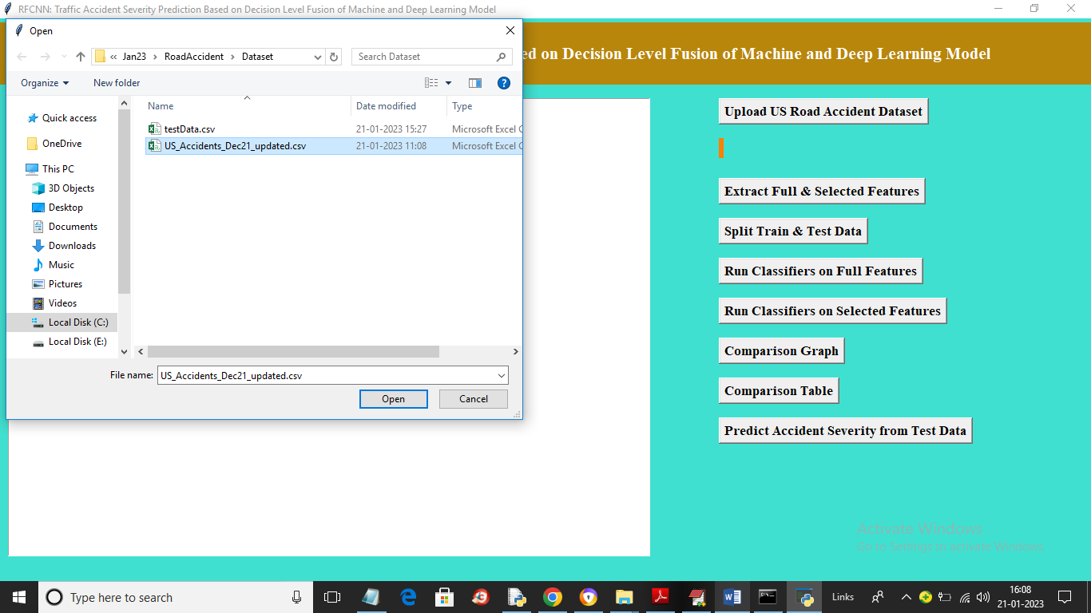
Results
In above screen click on ‘Upload US Road Accident Dataset’ button to upload dataset gget below screen
In above screen selecting and uploading dataset file and then click on ‘Open’ button to load dataset and get below output

Slide 23
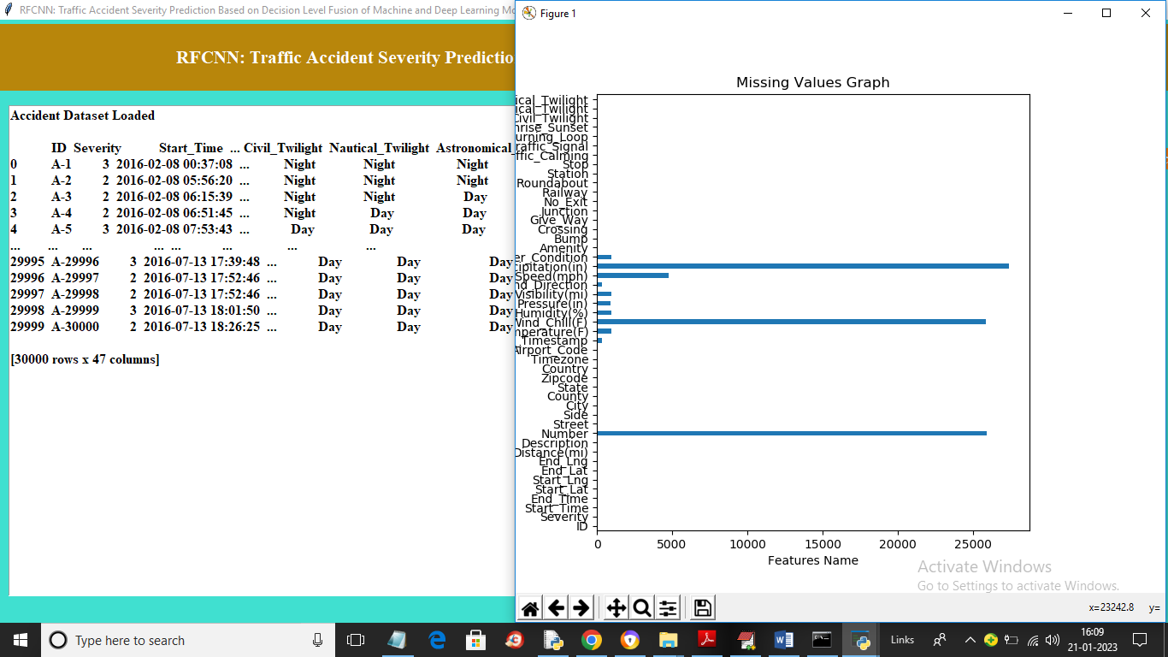
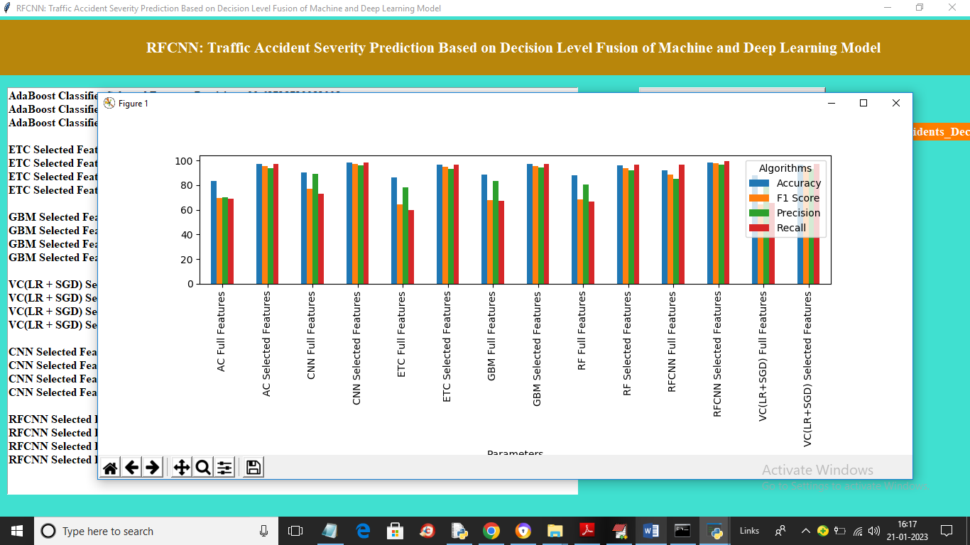
Results
The dataset initially contains several missing values, shown in the graph where the x-axis represents the count of missing values and the y-axis shows feature names. Clicking the 'Extract Full & Selected Features' button replaces missing values and separates the dataset into full and selected features.
In above graph x-axis represents algorithm names on full and selected features and y-axis represents accuracy and other metrics in different colour bars and in all we can see selected features algorithm got high performance and now click on ‘Comparison Table’ button to get below output

Slide 24
Conclusions & Future Enhancement
The proposed system effectively predicts traffic accident severity by combining Random Forest (RF) and Convolutional Neural Networks (CNN), achieving high accuracy and reliable results.
By focusing on the top 20 significant features, the model reduces data complexity while maintaining excellent performance.
The system’s ability to handle noisy data and provide real-time predictions makes it suitable for practical deployment in traffic management systems.
The model can be enhanced by integrating real-time sensor data from IoT devices to improve prediction speed and accuracy.
Expanding the dataset to include data from different geographic regions can further improve the model's adaptability and effectiveness in diverse traffic conditions.

Slide 25
References
Paper 1 | Zhang, Y., Liu, X., and Wang, L., 2021. Real-Time Traffic Accident Severity Prediction Using Machine Learning Techniques. IEEE Access, 9, pp.134256-134267.
Paper 2 | Chen, Z., Wu, X., and Zhang, Y., 2020. Deep Learning-Based Traffic Flow Prediction With Spatio-Temporal Data. Journal of Big Data, 7(1), pp.1-18.
Paper 3 | Gao, J., Lu, Y., and Shi, W., 2022. Accident Severity Prediction Using Hybrid Machine Learning Models. Transportation Research Part C: Emerging Technologies, 134, pp.103485..

Slide 26
References
Paper 4 | Ali, M., Khan, S., and Farooq, U., 2021. Predictive Analytics for Traffic Incident Severity Using Random Forest and Gradient Boosting. IEEE Transactions on Intelligent Transportation Systems, 22(6), pp.3541-3553.
Paper 5 | Koesdwiady, A., Soua, R., and Karray, F., 2016. Improving Traffic Flow Prediction With Weather Information in Connected Cars: A Deep Learning Approach. IEEE Transactions on Vehicular Technology, 65(12), pp.9508-9517.
Paper 6 | Huang, C., Zhou, F., and Zhang, J., 2019. A CNN-Based Framework for Traffic Accident Severity Prediction Using Road Network Data. Journal of Intelligent Transportation Systems, 23(3), pp.223-235.

Slide 27
Thank You
Any Queries/Suggestions?

